Slide 1
If condition
False
True
Operation and Exit
Else if Condition
False
True
Operation and Exit
else
Operation and Exit

Slide 2
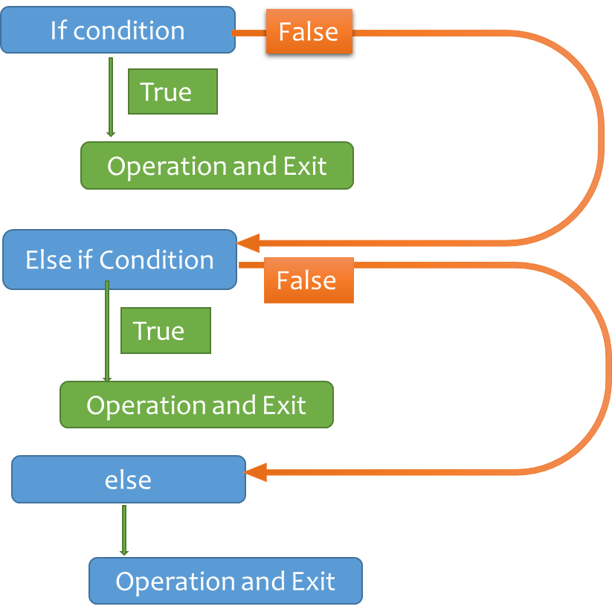
i=-5
If i <= 10
False
True
Print(“value less than 10)
Else if i <= 15
False
True
Print(“value less than 15)
else
Print(“value greater than 15)

Slide 3
While Loop
False
True
Operation
increment
Exit while Loop

Slide 4
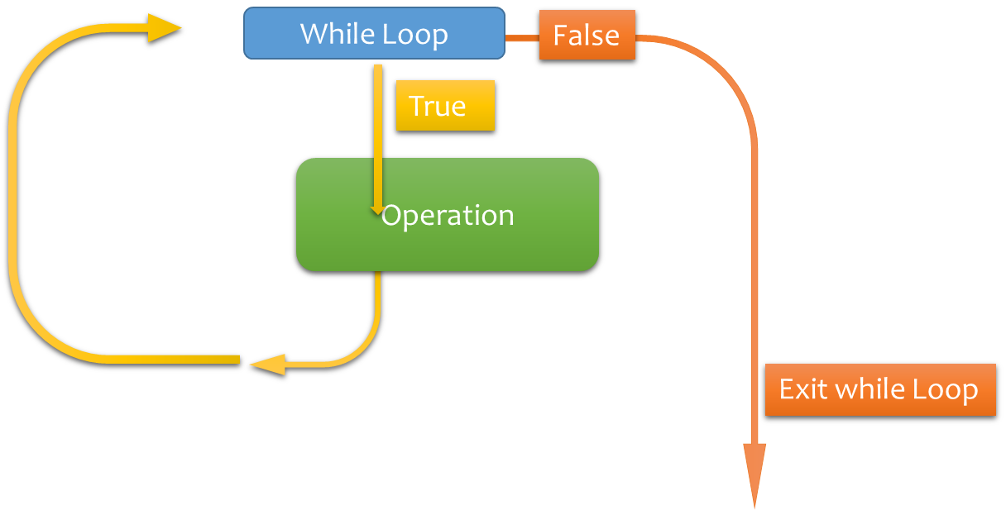
i = 0
While i <= 10:
False
True
Print( i )
i = i +1
0
1
2
3
4
5
6
7
8
9
10
Exit while Loop

Slide 5
For Loop Last Item Reached
True
False
Operation
Exit For Loop

Slide 6


Slide 7
Last Item reached or not?
For i in Range(0,10):
True
False
Print( i )
0
1
2
3
4
5
6
7
8
9
Exit while Loop

